Slide 1
Analytics Training
Kickoff Deck
Nedie Recel
May 31, 2019

Slide 2
Agenda layout
Introduction to Analytics
Data Dictionary - Google Analytics
Data Dictionary - VA.gov Tracking
Process for Analytics

Slide 3
Introduction to VA.gov Analytics

Slide 4
Analytics Timeline
June 2017 - Transitioned from standard (free) Google Analytics (GA) to GA360 for Vets.gov
May 2018 - Began consolidating other parts of VA.gov onto a new Google Analytics property for the Web Brand Consolidation (WBC)
November 2018 - Launched WBC VA.gov site and deprecated Vets.gov website and GA property
Notes:
To do: Confirm with Chante. Set

Slide 5
Data Dictionary: Google Analytics
Users: Total number of visitors to your property for the requested time period (as defined by cookies)
Sessions: Total number of sessions (session ends after 30 min of inactivity by default)
Pageviews: The total number of views of pages, including duplicate views of one page in one session
Unique Pageviews: The total times a pages was uniquely viewed within a session
Events: The total number of events, including duplicate attempts in one session
Unique Events: The number of events that occur distinctly in one session
Goal Completions: The total number of completions for a Goal (defined by Page, Event, or Time or Pages per Visit)
Goal Conversion Rate: Rate at which visitors achieve key actions on your site or app
Notes:
To do: Confirm with Chante. Set

Slide 6
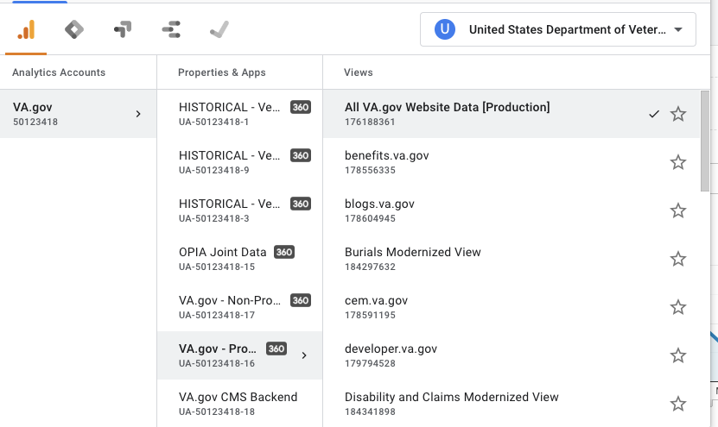
Data Dictionary: Google Analytics
Account - VA.gov
Property - Main Properties are Production and Staging
Views - Lowest in the hierarchy of account structure for VA.gov and can be customized to filter by certain criteria (mostly subdomains or subdirectories)
Notes:
To do: Confirm with Chante. Set

Slide 7
Data Dictionary: VA.gov Analytics
DAP vs. VA.gov’s GA360
Event Naming Convention
Event Categories:
Sign-On
Transactions
Navigation
Interactions
API Calls
Internal
Errors
Notes:
To do: Confirm with Chante. Set

Slide 8
Data Dictionary: VA.gov Analytics
Goal Tracking
In most cases, goals are incremented for tools when a user reaches the Thank You page in a session
In some cases, goals are incremented when an event takes place
Notes:
To do: Confirm with Chante. Set

Slide 9
Analytics Best Practices

Slide 10
Analytics Process
PM works with Insights team to define KPIs and tracking
Helpful data calls:
Wireframes
Recommended users (e.g. both LOA1/LOA3)
Analytics drafts any new requirements for FE teams
In parallel, Insights creates or modifies Google Tag Manager (GTM) and Google Analytics
FE notifies Insights team when it’s ready on Staging for validation
Insights validates, then publishes changes in GTM
Notes:
To do: Confirm with Chante. Set

Slide 11
Q&A

